Slide 1
Chain of Responsibility Pattern
Nikitha Katta
Venkata Govardhan Goli
Mounica Dandamudi

Slide 2
Chain of responsibility
It is a behavioral design pattern.
To avoid the coupling between the sender and receiver by sending many objects chance to handle.
Receiving objects are chained and are passed in the chain until the object is handled.

Slide 3
Participants
Handler – defines interface for handling requests. Can also implement successor link.
ConcreteHandler –Forwards requests to successor.
Client – initiates request to a ConcreteHandler in the chain.

Slide 4
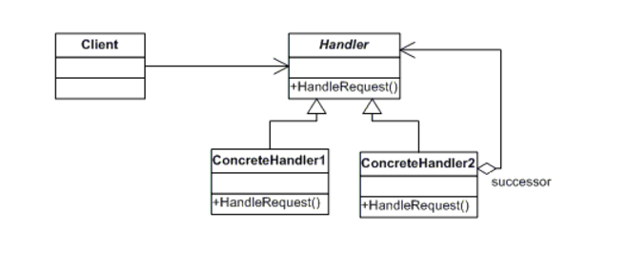
UML Diagram

Slide 5
Benefits
Decoupling of senders and receivers.
Added flexibility.
There is no need that sender should know specifically who the handlers are.

Slide 6
Drawbacks
Client can’t explicity specify who handles a request.
No guarantee of request being handled (request falls off end of chain).

Slide 7
Examples
CHAIN.JAVA
NUMBERS.JAVA
ADDNUMBERS.JAVA
SUBTRACTNUMBERS.JAVA
MULTNUMBERS.JAVA
DIVIDENUMBERS.JAVA
TESTCALCCHAIN.JAVA

Slide 8
Sample Code
class HelpHandler {
public:
HelpHandler(HelpHandler* s) : _successor(s) { }
virtual void HandleHelp();
private:
HelpHandler* _successor;
};
void HelpHandler::HandleHelp() {
if(_successor) {
_succeessor->HandleHelp();
}
}

Slide 9
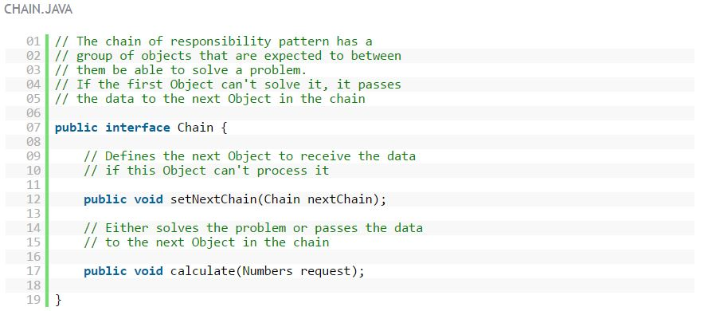
Examples

Slide 10
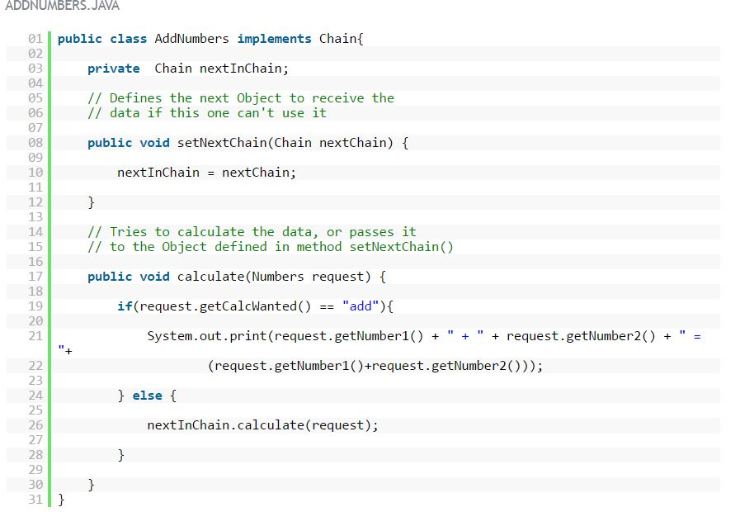
Examples

Slide 11
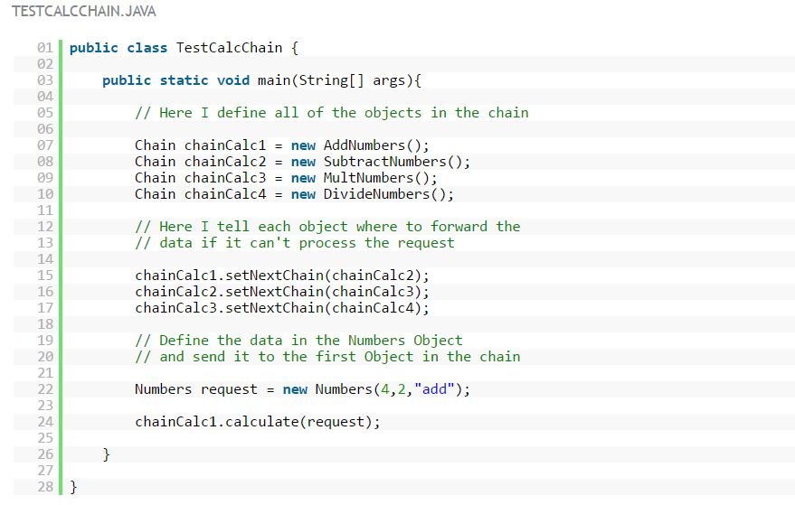
Examples

Slide 12
References
http://www.dofactory.com/net/chain-of-responsibility-design-pattern
http://www.newthinktank.com/2012/10/chain-of-responsibility-design-pattern-tutorial/

